Slide 1

Realms of Mastery
Alena Durel
04/17/2024
Majors: Computer Science and Cybersecurity Bachelor of Science
Advisor: Professor Julie Henderson

Slide 2
Project Description
Adventure-style game with Dungeons
Math Questions with ELA Questions as a future enhancement
Based on South Carolina Academic Standards
Audience: 3rd and 4th Grade Students
Notes:
Realms of Mastery is an adventure style game that is primarily intended for use by 3rd and 4th grade students and will be based on the South Carolina Academic Standards. The student will get to choose their character and fighting style (math or ELA based) and will travel the realm, while answering a variety of questions to defeat monsters, collect some treasure, and gather achievements. This game will also feature a boss rush mode that will allow students to practice questions geared towards a specific standard that they might be struggling with.

Slide 3
Statement of Purpose
Elementary-aged children have a very limited attention span and often get bored or distracted during lessons.
There is a need to develop innovative and creative solutions to engage and entertain students, while also cultivating their learning and understanding of the material.
Notes:
While teachers strive to educate their students in the classroom, they face challenges with keeping students engaged and actively learning. Elementary-aged children have a very limited attention span and often get bored or distracted during lessons. Thus, there is a need to develop innovative and creative solutions to engage and entertain students, while also cultivating their learning and understanding of the material. I propose an adventure style game that will provide students with a stimulating environment in which to reinforce the skills that they are taught in their lessons. This game will be aimed towards 3rd and 4th grade students and will be based on the South Carolina Academic Standards. By basing this game on the standards, it will not be taking away from time spent learning, but rather can be used as a tool to help fill the gaps and keep students engaged with the material. With the vast expansion of technology, it is important to find ways to integrate these advancements with education and use them to facilitate learning rather than hinder it.

Slide 4
Languages, Software, and Hardware
Language
Hardware
Developed on Macbook Pro
Tested on Macbook Pro and Windows PC
Software
IntelliJ - IDE used to develop this program
Visual Studio Code - IDE used to develop this program
CotEditor/Notepad++ - Text editor for configuring all \*.txt files used in this program
Piskel- Pixel art web app used to create sprites
Java

Slide 5
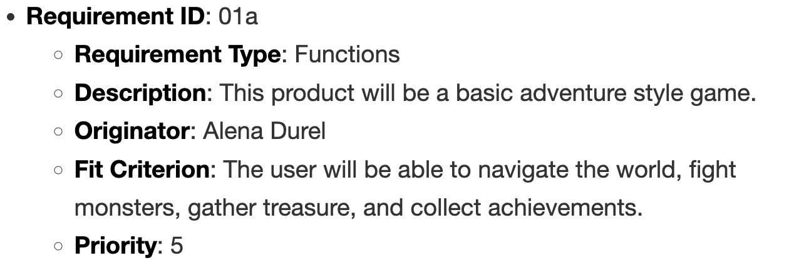
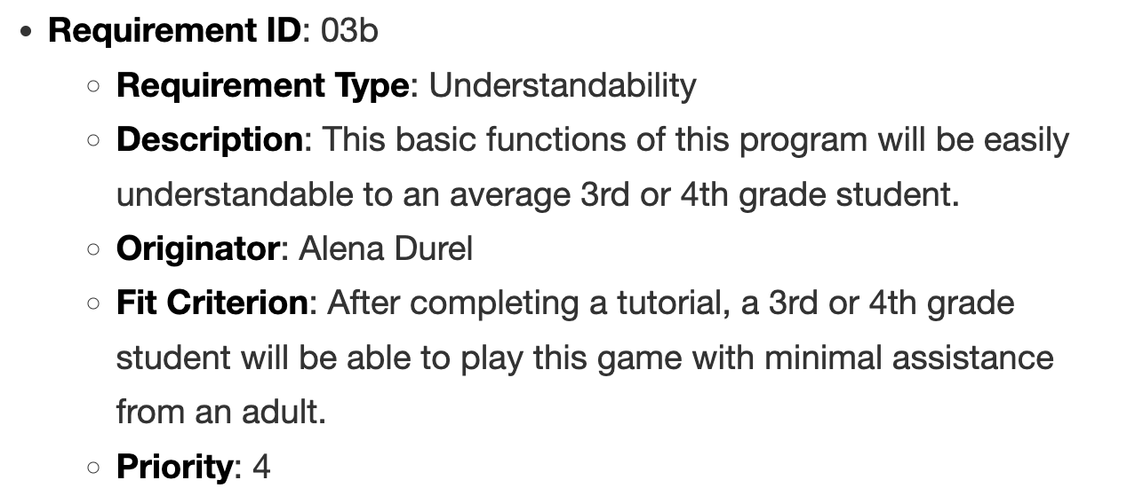
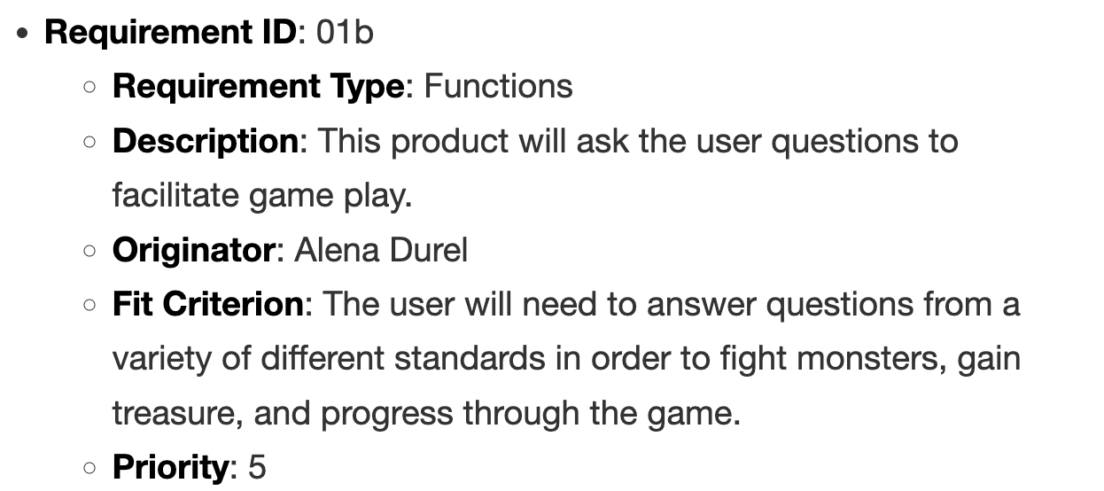
Requirements

Slide 6
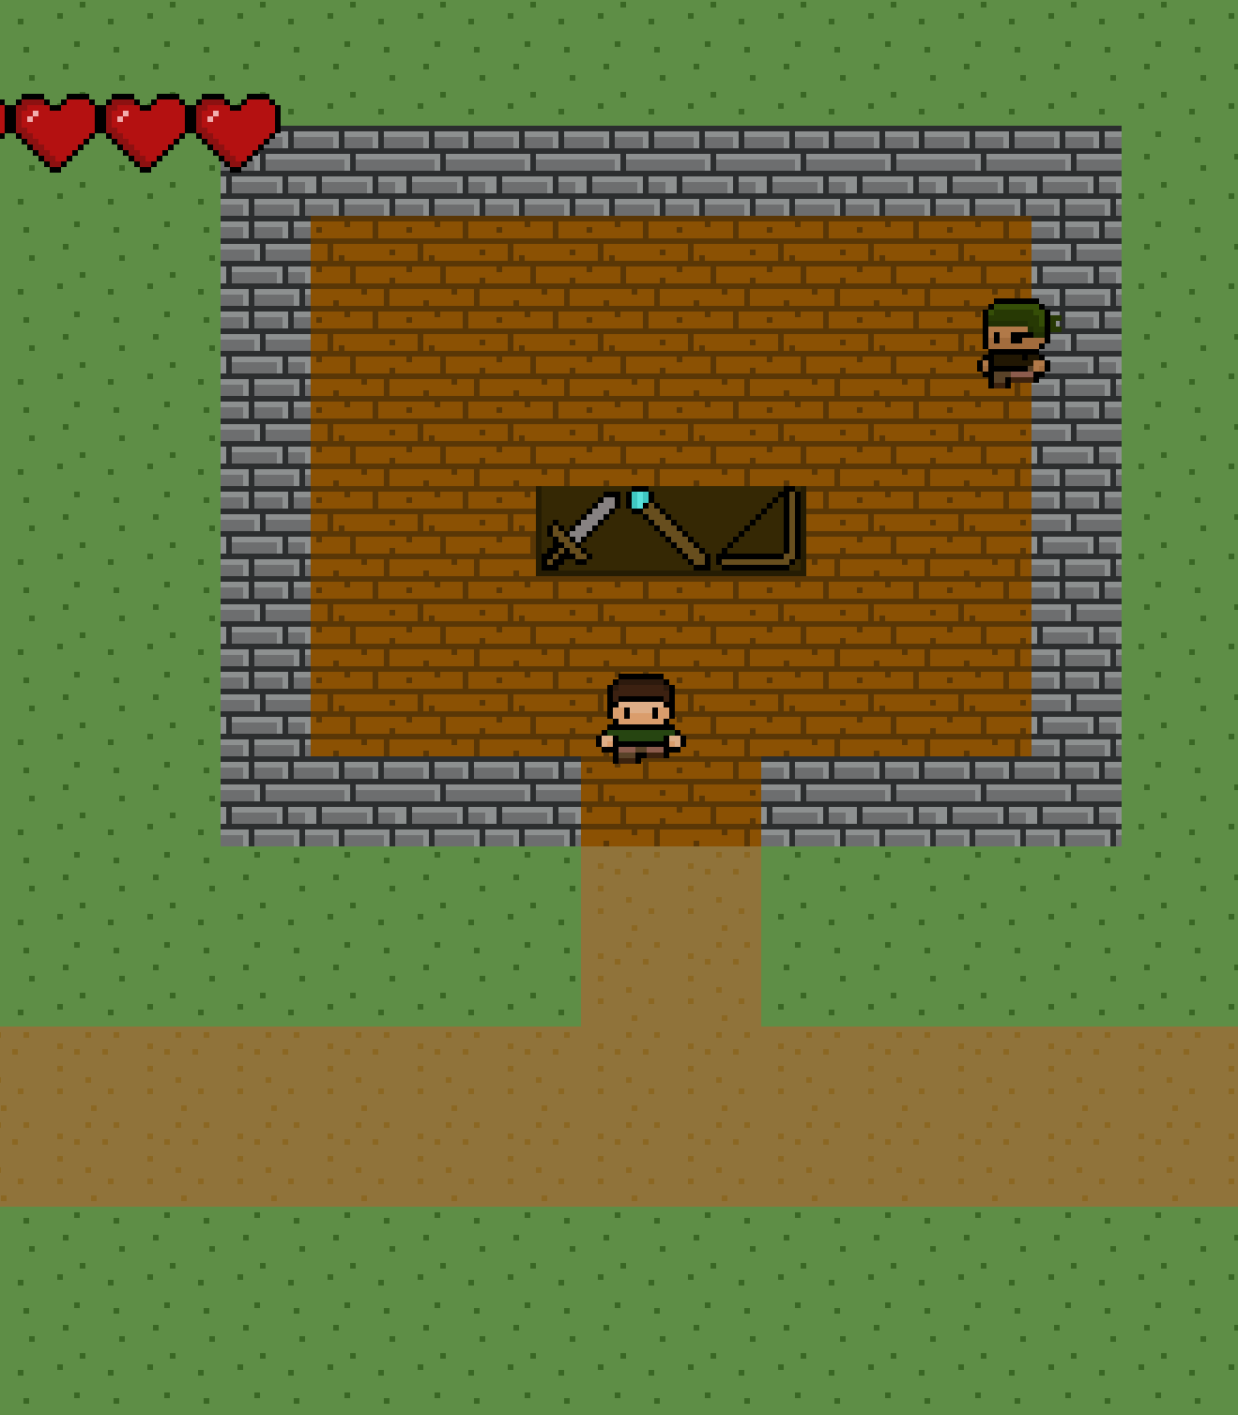
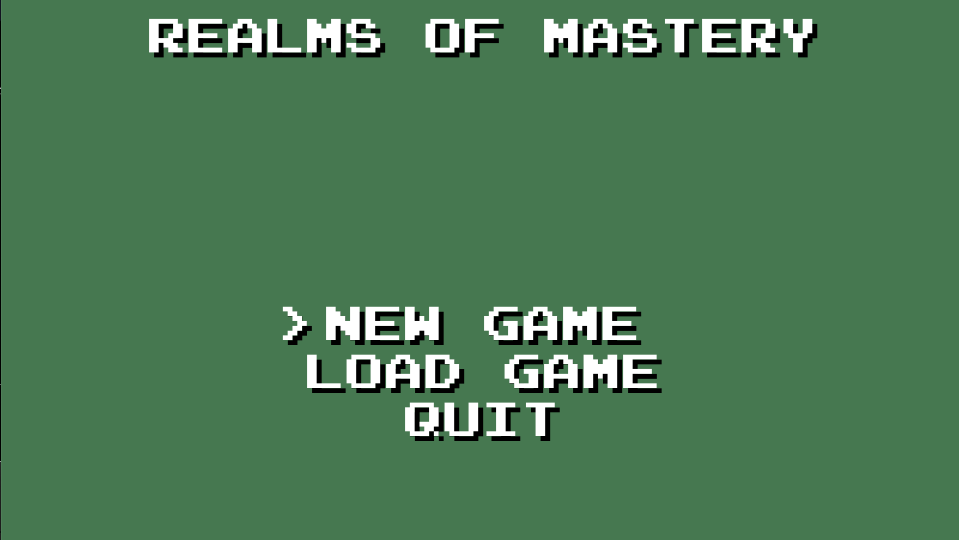
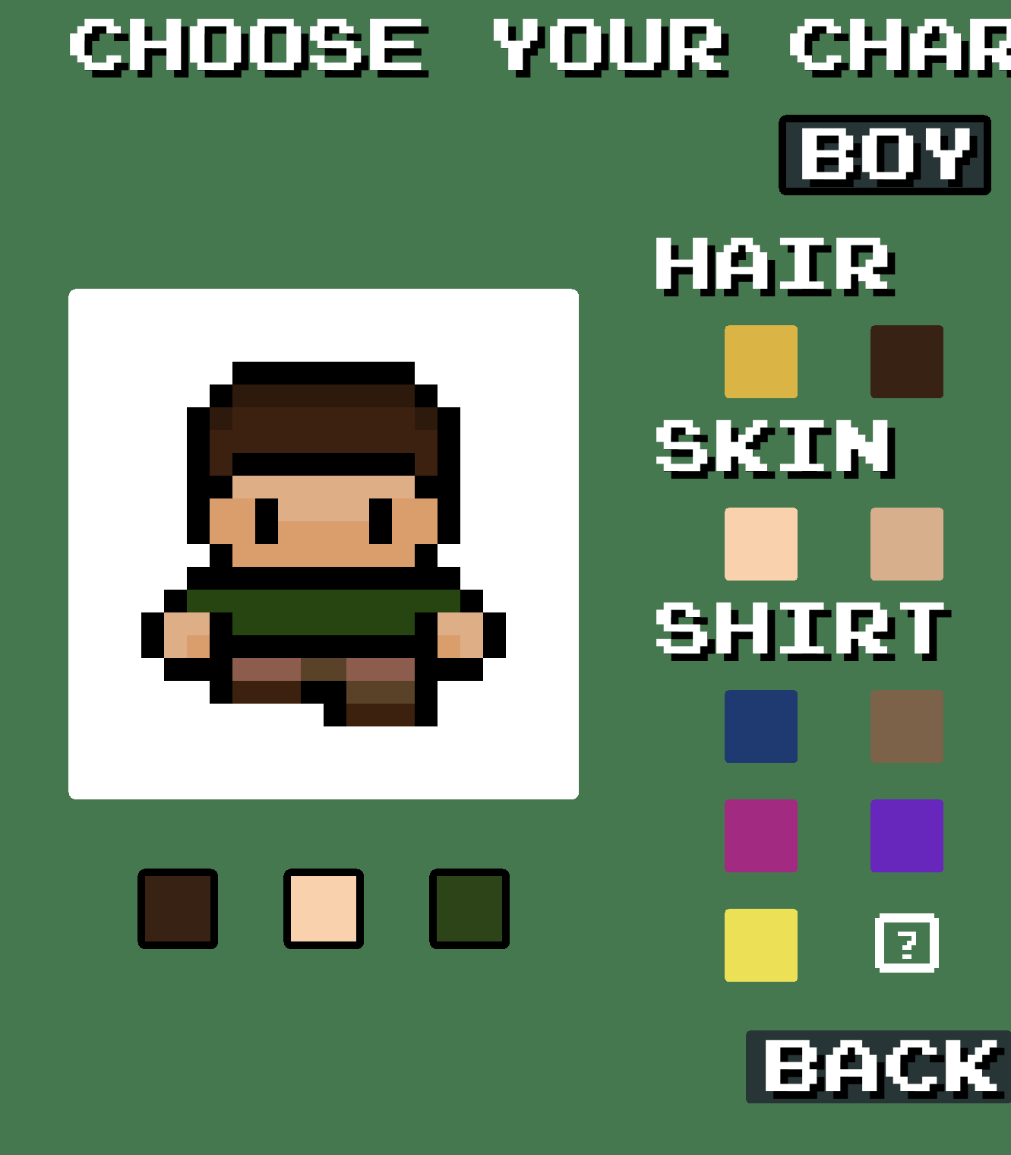
Project DEMO

Slide 7
Testing
Developer completed testing according to test plan
Outside tester tested input validation and test cases to attempt to break the game
Educational Consultant tested with four 4th grade students
2 high achievers, 1 average achiever, and 1 low achiever

Slide 8
Test Results
How was playing the game (character movement, menu navigation, etc.)?
Very Easy
How difficult did you find the questions asked?
Somewhat Hard

Slide 9
Test Results – Likes
Appearance of the game
Character customization
Large variety of colors and inclusive skin tones
Different Game Modes
Normal run, Boss Rush, Maze, and Super Chest hunting
Winning coins for answering questions
Unlockables and Shops
Map function
Helpful and easy to pull up

Slide 10
Test Results - Dislikes
Requiring scratch paper to do some of the problems
Some problems took too long to solve
In hindsight, educational consultant felt that the game would work better with more mental math or “strictly numbers” problem.
Playing with WASD keys
Was new for students used to playing games with arrow keys

Slide 11
Test Results - Suggestions
Student Suggestions:
Equipping a weapon helps you do more damage
Unlockables (outfits) also have a stat boost (movement speed, strength, health)
Teacher Suggestions:
More mental math and rote questions (maybe basic times tables and division facts to practice)
If switching to these types of questions, maybe timed questions (to promote automaticity with facts)
Progress bars for Boss Rush and Super Chests
Encouraging messages for correct answers

Slide 12
Challenges Overcome
Expanded knowledge base in Java and GUI development
Learned how to use a Java Profiler to locate and correct performance issues
Testing was not able to be done with an entire classroom
Time management with a full-time internship

Slide 13
Future Enhancements
Based on Suggestions
Developer Enhancements
Add option to set key bindings.
Add different stats enhancements for weapons and outfits.
Adjust Math Questions for a more mental math focus.
Add visual progress bar for Boss Rush Mode.
Add messages for correct answers to show progress and reward.
Support for ChromeOS
Auto-save: Support for auto-saving the game.
Fighting Style Selection: The player will be able to select between an ELA or Math-based fighting style.
ELA Questions: Support for ELA questions to appear in the game.
Personalized Boss Rush: Support for Boss Rush feature to be personalized with custom questions provided by teachers.

Slide 14
Questions?

